Slide 1
C_lines
A self-play reinforcement-learning agent for an original board game
ITRI 616 Artificial Intelligence 1 · 8×8 board · points-until-full · run_pts_002 (10,000 self-play games)
Notes:
[~15s | running 0:15]
Hi. This project is C_lines, an original two-player board game I designed, and an agent that learns to play it well entirely by playing against itself. In the next few minutes I'll cover three things: the problem, the algorithm, and the evidence that the agent improves with experience.

Slide 2
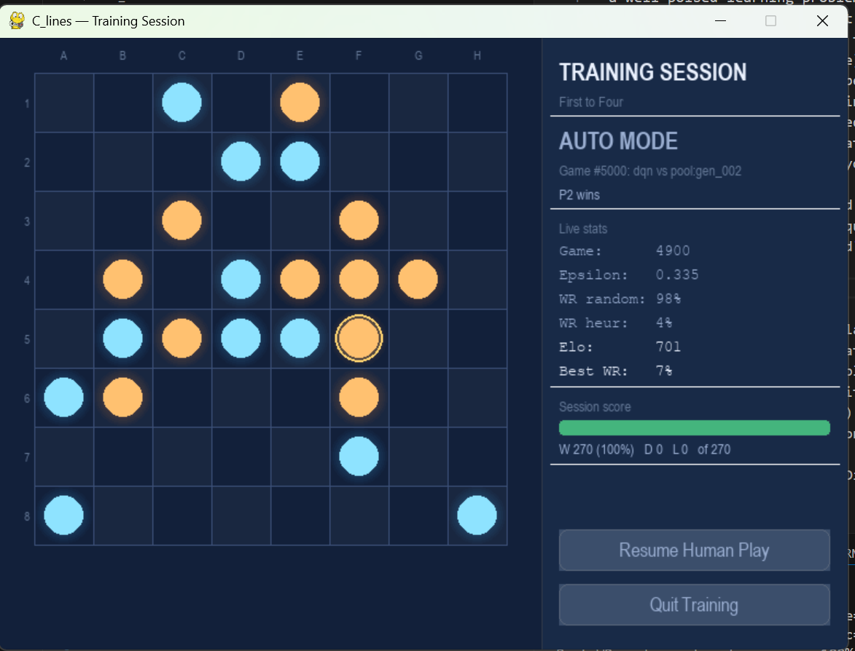
The game: C_lines on an 8×8 board
PROBLEM DEFINITION
• Open placement, players alternate, placing one stone on ANY empty cell; no gravity, no column rule.
• Board fills, play continues until all 64 cells are occupied.
• Line scoring , score for straight runs (any direction) of length 3–8; longer lines worth far more (3 → 0.25 … 8 → 5.0).
• Win condition, highest total score when the board fills; a tie-break removes draws.
• There are possible 64 opening moves; you must BUILD your own lines and BLOCK the opponent over a 64-move horizon.
Notes:
[~35s | running 0:50]
C_lines is played on an eight-by-eight board. Players take turns placing one stone on any empty cell, there's no gravity and no column rule, you can play anywhere. Play continues until the board is full, sixty-four stones. You score for straight lines of your own stones in any direction, and longer lines are worth far more, a three is a quarter point, scaling up to five points for a line of eight. Highest score when the board fills wins. What makes it hard: every move you have to both build your own lines and block your opponent's, over a sixty-four-move game.

Slide 3
The learning problem
PROBLEM DEFINITION & TEP FRAMEWORK
T
Task
E
Experience
P
Performance
Choose the placement that maximises the final score margin (own − opponent). Category: sequential DECISION-MAKING / CONTROL
Self-generated games: a short warm-up vs Random & Heuristic, then SELF-PLAY against frozen past versions. As the agent improves, so do its opponents
Four metrics every 100 games: win rate vs Random, vs Heuristic, an Elo rating, and win rate vs a 4-ply Alpha-Beta search.
Goal of the assignment: demonstrate that performance improves with experience.
Notes:
[~38s | running 1:28]
I framed this with Mitchell's Task, Experience, Performance structure. The Task: given a board, choose the placement that maximises my final score margin. In category terms it's sequential decision-making and control, not classification, and not prediction, because the agent has to act and its actions decide the outcome. The Experience is self-play: a short warm-up against a random and a heuristic opponent, then the agent plays frozen copies of its earlier selves, so as it improves, its opponents improve too. And Performance is measured four ways, win rate versus random, versus the heuristic, an Elo rating, and against a four-ply search.

Slide 4
The algorithm: a self-play Deep Q-Network
TECHNICAL UNDERSTANDING & METHODOLOGY
10-channel board state
Residual CNN (4 blocks, 64ch)
Q-value per cell
ε-greedy move
→
→
→
Learning loop: transitions are stored in a replay buffer and feed gradient updates.
Why DQN?
• Sequential control with delayed reward, a move's value only emerges when the board fills.
• Q-learning's TD target is built for that credit assignment.
• No labelled 'correct' moves exist for an original game, so supervised learning does not apply.
Reward design
• Dense delta-score shaping: per-move change in (own − opponent) score.
• Plus a terminal ±1 for the win / loss.
• Every step points to the same goal as the final outcome.
Notes:
[~38s | running 2:06]
The algorithm is a Deep Q-Network, value-based reinforcement learning. A neural network estimates the value of each possible move, and the agent plays the highest-valued legal cell. The board goes in as a ten-channel image, my stones, the opponent's, empty cells, and tactical layers like where my three-in-a-rows are. The network is a residual convolutional network, which is well suited to spotting line patterns. I chose DQN because this is sequential control with delayed reward, a move's value only emerges when the board fills, and there are no labelled correct moves for an original game, so supervised learning doesn't apply. The reward is the per-move change in score margin, perfectly aligned with the objective.

Slide 5
Three implementation choices that make it work
TECHNICAL UNDERSTANDING & METHODOLOGY
Negamax value target
The next position is the OPPONENT's, so the bootstrap is subtracted, not added: target = r − γ·max Q(s′).
Double DQN + Huber loss
The online net selects the action, the target net evaluates it — cutting overestimation. Huber loss keeps updates stable against large TD errors. Together: no late-run collapse.
D4 symmetry augmentation
Every board is also 7 rotations / reflections — multiplying training data eight-fold for free and regularising toward the board's true symmetry.
Plus: target-network sync, gradient clipping, plateau LR decay, and snapshotting every 1,000 games into 10 playable difficulty levels.
Notes:
[~33s | running 2:39]
Three choices made it work. First, the negamax target: because the next position belongs to my opponent, the bootstrap is subtracted, not added. Correctness detail in two-player value learning. Second, Double DQN and a Huber loss keep the value estimates stable and prevent the late-training collapse that plain DQN suffers. Third, I exploit the board's eight-fold symmetry, which multiplies my training data for free. And every thousand games I freeze a snapshot and register it as a playable difficulty level.

Slide 6
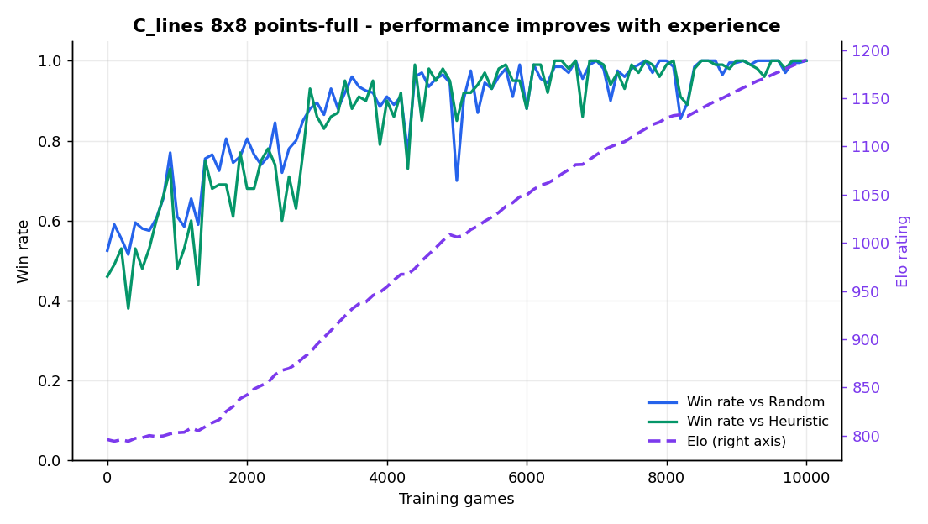
Result: performance improves with experience
RESULTS PRESENTATION & ANALYSIS
796 → 1190
Elo (monotone, +394)
52.5% → 100%
Win rate vs Random
46% → 100%
Win rate vs Heuristic
Notes:
[~33s | running 3:12]
Here's the core result, one run of ten thousand games. Win rate against random and against the heuristic both climb from about half to a hundred percent. But the headline is the Elo rating, the purple curve, it rises monotonically from 796 to 1190, nearly four hundred points, with no collapse. That smooth rising curve is exactly the assignment's claim, performance improving with experience, shown directly. And because Elo keeps rising after the win rates hit their ceiling, it shows the agent kept improving even when the baselines could no longer measure it.

Slide 7
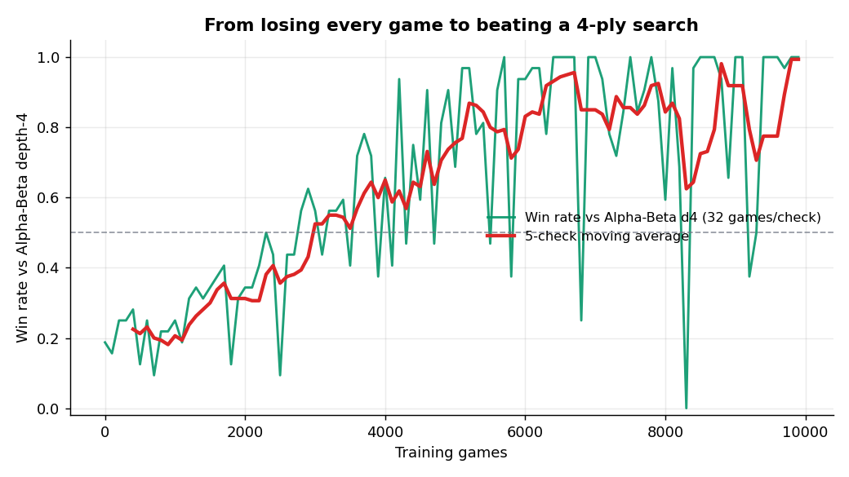
The decisive test: beating a 4-ply search
RESULTS PRESENTATION & ANALYSIS
vs Alpha-Beta depth-4
an opponent the agent NEVER trains against
19% → 100%
win rate
−0.83 → +1.17
mean score margin (sign flips)
Winning by a margin against an independent search = genuine generalisation, not memorisation.
Notes:
[~28s | running 3:40]
The strongest evidence is against a four-ply alpha-beta search that the agent never trains against. Early on it wins about nineteen percent and loses on score, by a margin of minus 0.83. By the end it wins essentially a hundred percent, and the score margin flips to plus 1.17. Winning by a margin against an independent search it cannot have memorised, the tree is far too large, means the agent genuinely generalised.

Slide 8
Critical analysis
CRITICAL THINKING
Model
Residual CNN matches local line patterns; tactical channels free the network to weigh threats, not relearn rules.
Method
Negamax target keeps the value function coherent; Double-DQN + Huber explain the stable, collapse-free convergence.
Results
Win rates saturate at 100% - Elo keeps resolving improvement; the per-snapshot noise is why Elo is the headline.
Improve
Multi-seed bands, n-step returns, an AlphaZero-style policy + MCTS head, and a deeper benchmark.
Notes:
[~35s | running 4:15]
A critical look, in four parts. The model: the residual CNN matches local line patterns, and the tactical channels free it to weigh threats rather than relearn the rules. The method: the negamax target keeps the value function coherent, and Double DQN with Huber loss explains the stable, collapse-free convergence. The results: the win rates saturate at a hundred percent, which is why I lean on Elo, and the per-snapshot noise is why a single curve is more trustworthy than any one point. To improve: multi-seed confidence bands, n-step returns, and an AlphaZero-style policy-and-search head.

Slide 9
A self-play DQN learned an original board game, from a blank slate to out-playing a 4-ply search
IN ONE SENTENCE
1,190
final Elo
100%
vs Random, Heuristic & AB-d4
10,000
self-play games
Clear, quantitative evidence that performance improves with experience. Every result is reproducible from the logged data with one command.
python -m src.training.train --games 10000 --size 8 --benchmark alphabeta_d4
Thank you - questions welcome.
Notes:
[~20s | running 4:35]
In one sentence: a self-play Deep Q-Network learned an original board game, from a blank slate to out-playing a four-ply search, clear, quantitative evidence that performance improves with experience. Final Elo of eleven-ninety, a hundred percent against every fixed opponent, and every result reproducible from the logged data with one command. Thank you for watching.

